Slide 1
JAVASCRIPT

Slide 2
JavaScript is THE scripting language of the Web.
JavaScript is used in billions of Web pages to add functionality, validate forms, communicate with the server, and much more.
JavaScript is the most popular scripting language on the internet, and works in all major browsers, such as Internet Explorer, Firefox, Chrome, Opera, and Safari.

Slide 3
What is JavaScript?
JavaScript was designed to add interactivity to HTML pages
JavaScript is a scripting language
A scripting language is a lightweight programming language
JavaScript is usually embedded directly into HTML pages
JavaScript is an interpreted language (means that scripts execute without preliminary compilation)
Everyone can use JavaScript without purchasing a license

Slide 4
Are Java and JavaScript the same?
NO!
Java and JavaScript are two completely different languages in both concept and design!
Java (developed by Sun Microsystems) is a powerful and much more complex programming language - in the same category as C and C++.

Slide 5
HTML vs. Javascript
Javascript is not HTML.
The two languages co-exist but still they are separate. (Analogy: TV and a DVD).
Javascript is very much difficult as compared with html.

Slide 6
If Javascript is a scripting language, not a programming language what then is a Scripting language.
As compared with programming scripting is a lot easier since programming involves too many activities it is rather more complicated to program than to script.
There are more rules and or syntax to follow in programming than scripting.
Scripting is simple and straightforward.
Scripts are interpreted not compiled.

Slide 7
What Can JavaScript do?
JavaScript gives HTML designers a programming tool - HTML authors are normally not programmers, but JavaScript is a scripting language with a very simple syntax! Almost anyone can put small "snippets" of code into their HTML pages
JavaScript can react to events - A JavaScript can be set to execute when something happens, like when a page has finished loading or when a user clicks on an HTML element
JavaScript can read and write HTML elements - A JavaScript can read and change the content of an HTML element
JavaScript can be used to validate data - A JavaScript can be used to validate form data before it is submitted to a server. This saves the server from extra processing
JavaScript can be used to detect the visitor's browser - A JavaScript can be used to detect the visitor's browser, and - depending on the browser - load another page specifically designed for that browser

Slide 8
Javascript whereTo?
JavaScripts in the body section will be executed WHILE the page loads.
JavaScripts in the head section will be executed when CALLED.

Slide 9
Examples
Head section
Scripts that contain functions go in the head section of the document. Then we can be sure that the script is loaded before the function is called.
Body section
Execute a script that is placed in the body section.
External script
How to access an external script.

Slide 10
Basic JavaScript Examples
1. Internal Javascript
<html>
<body>
<h1>My First Web Page</h1>
<script type="text/javascript">
document.write("<p>" + Date() + "</p>");
</script>
</body>
</html>

Slide 11
2. An External JavaScript
<html>
<head>
</head>
<body>
<script type="text/javascript" src="xxx.js">
</script>
<p>
The actual script is in an external script file called "xxx.js".
</p>
</body>
</html>

Slide 12
JavaScript Statements, Comments and Blocks
3. Inline Javascript
<html>
<body>
<h1>My First Web Page</h1>
<a href=“javascript:history.back()”>Previous Page </a>
</body>
</html>

Slide 13
JavaScript Statements
JavaScript is a sequence of statements to be executed by the browser.
JavaScript is Case Sensitive
Unlike HTML, JavaScript is case sensitive - therefore watch your capitalization closely when you write JavaScript statements, create or call variables, objects and functions.
JavaScript Statements
A JavaScript statement is a command to a browser. The purpose of the command is to tell the browser what to do.
Notes:
It is normal to add a semicolon at the end of each executable statement. Most people think this is a good programming practice, and most often you will see this in JavaScript examples on the web.
The semicolon is optional (according to the JavaScript standard), and the browser is supposed to interpret the end of the line as the end of the statement. Because of this you will often see examples without the semicolon at the end.
Note: Using semicolons makes it possible to write multiple statements on one line.

Slide 14
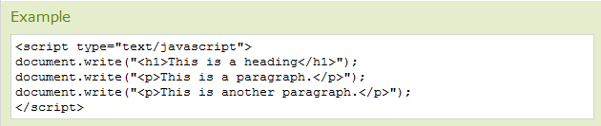
JavaScript Code
JavaScript code (or just JavaScript) is a sequence of JavaScript statements.
Each statement is executed by the browser in the sequence they are written.

Slide 15
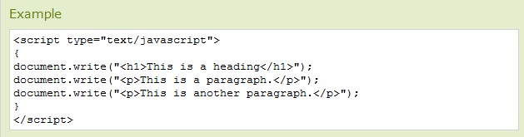
JavaScript Blocks
JavaScript statements can be grouped together in blocks.
Blocks start with a left curly bracket {, and ends with a right curly bracket }.
The purpose of a block is to make the sequence of statements execute together.

Slide 16
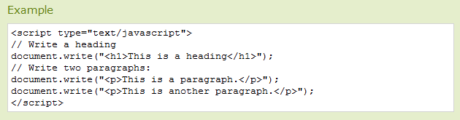
JavaScript Comments
Comments can be added to explain the JavaScript, or to make the code more readable.
Single line comments start with //.

Slide 17
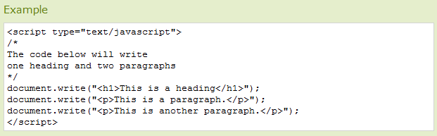
JavaScript Multi-Line Comments
Multi line comments start with /* and end with */.

Slide 18
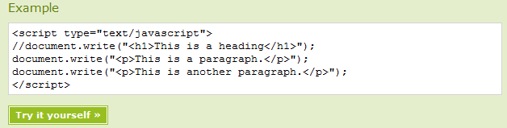
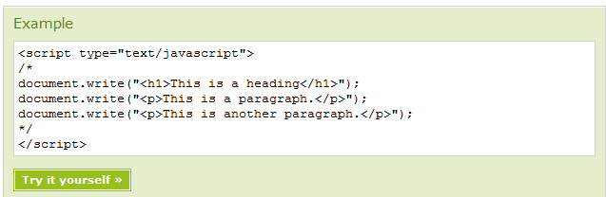
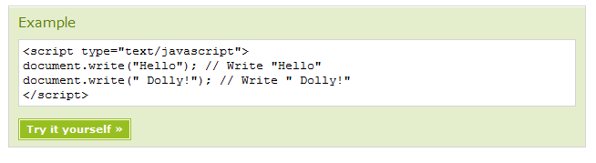

Slide 19
JavaScript Variables
JavaScript variables are used to hold values or expressions.
A variable can have a short name, like x, or a more descriptive name, like carname.
Rules for JavaScript variable names:
Variable names are case sensitive (y and Y are two different variables)
Variable names must begin with a letter or the underscore character

Slide 20


Declaring (Creating) JavaScript Variables
Creating variables in JavaScript is most often referred to as "declaring" variables.
You can declare JavaScript variables with the var statement:

Slide 21
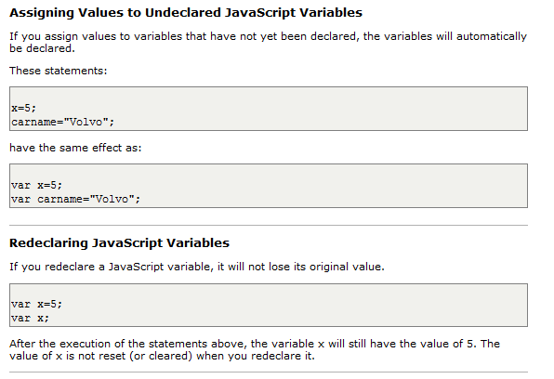
Assigning Values to Undeclared Variables

Slide 22
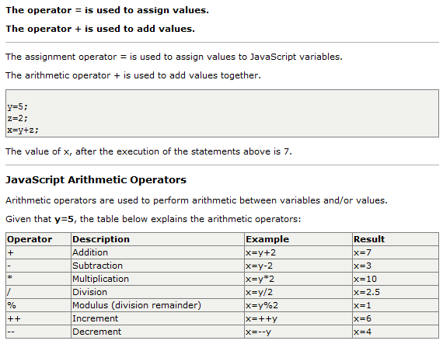
JavaScript Arithmetic

Slide 23
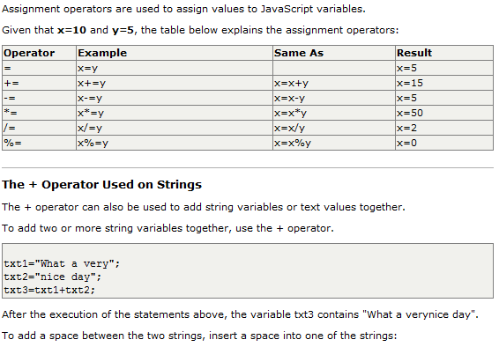
JavaScript Assignment Operators

Slide 24
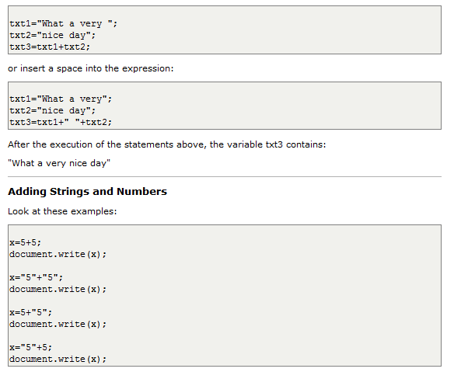

Slide 25
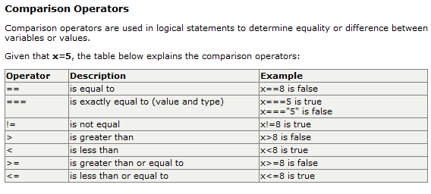
JavaScript Comparison and Logical Operators

Slide 26
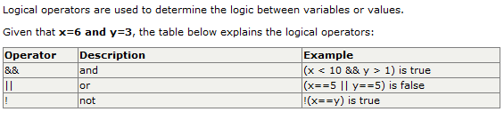
How Can it be Used
Comparison operators can be used in conditional statements to compare values and take action depending on the result:
LOGICAL Operators

Slide 27
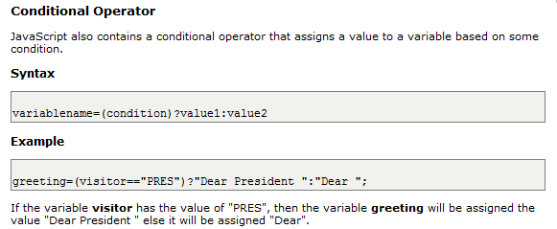

Slide 28
JavaScript If...Else Statements
Conditional statements in JavaScript are used to perform different actions based on different conditions.
Conditional Statements
Very often when you write code, you want to perform different actions for different decisions. You can use conditional statements in your code to do this.
In JavaScript we have the following conditional statements:
if statement - use this statement if you want to execute some code only if a specified condition is true
if...else statement - use this statement if you want to execute some code if the condition is true and another code if the condition is false
if...else if....else statement - use this statement if you want to select one of many blocks of code to be executed
switch statement - use this statement if you want to select one of many blocks of code to be executed

Slide 29
If Statement
You should use the if statement if you want to execute some code only if a specified condition is true.
Syntax
if (condition) {
code to be executed if condition is true }
Note: that if is written in lowercase letters. Using uppercase letters (IF) will generate a JavaScript error!

Slide 30
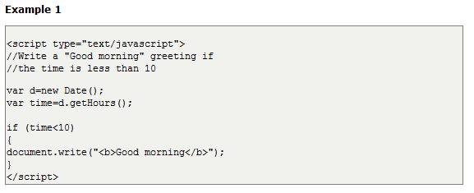
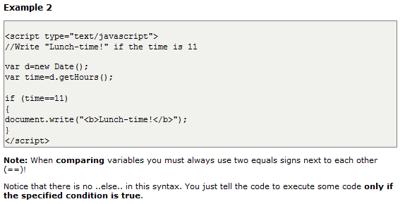
Examples:

Slide 31
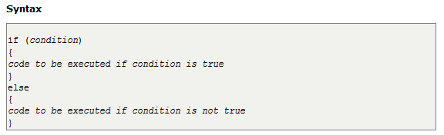
IF-ELSE
If...else Statement
If you want to execute some code if a condition is true and another code if the condition is not true, use the if....else statement.

Slide 32
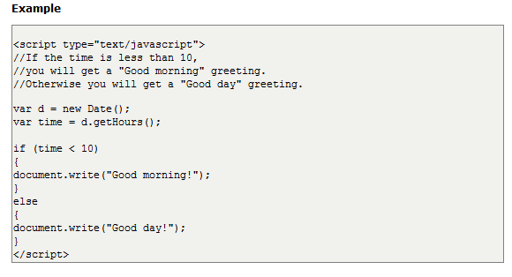

Slide 33
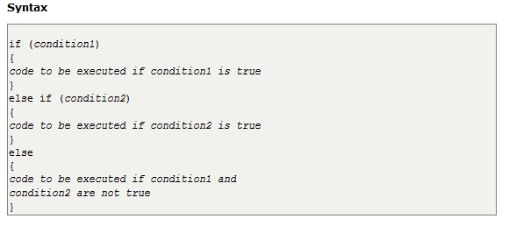
If...else if...else Statement
You should use the if....else if...else statement if you want to select one of many sets of lines to execute.

Slide 34
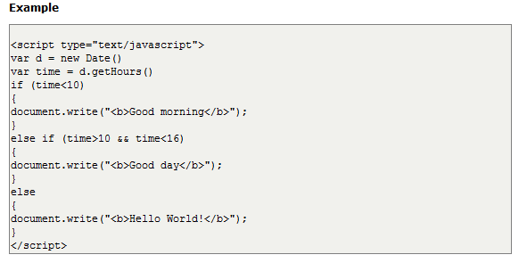
Examples…

Slide 35
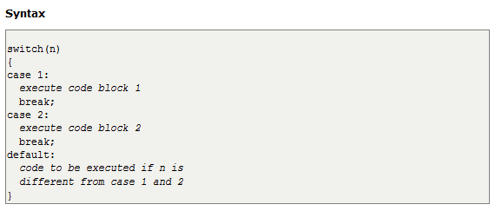
JavaScript Switch Statement
The JavaScript Switch Statement
You should use the switch statement if you want to select one of many blocks of code to be executed
Notes:
This is how it works: First we have a single expression n (most often a variable), that is evaluated once. The value of the expression is then compared with the values for each case in the structure. If there is a match, the block of code associated with that case is executed. Use break to prevent the code from running into the next case automatically.

Slide 36
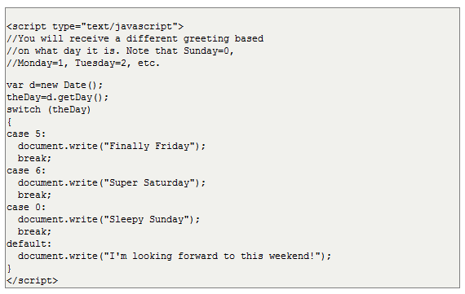
Examples:

Slide 37
JavaScript Popup Boxes
Alert Box
An alert box is often used if you want to make sure information comes through to the user.When an alert box pops up, the user will have to click "OK" to proceed.
Syntax:
alert("sometext");

Slide 38
Confirm Box
A confirm box is often used if you want the user to verify or accept something.
When a confirm box pops up, the user will have to click either "OK" or "Cancel" to proceed.
If the user clicks "OK", the box returns true. If the user clicks "Cancel", the box returns false.
Syntax:
confirm("sometext");

Slide 39
Prompt Box
A prompt box is often used if you want the user to input a value before entering a page.
When a prompt box pops up, the user will have to click either "OK" or "Cancel" to proceed after entering an input value.
If the user clicks "OK" the box returns the input value. If the user clicks "Cancel" the box returns null.
Syntax:
prompt("sometext","defaultvalue");

Slide 40
JavaScript Functions
A function is a reusable code-block that will be executed by an event, or when the function is called
A function contains code that will be executed by an event or by a call to that function.
You may call a function from anywhere within the page (or even from other pages if the function is embedded in an external .js file).

Slide 41
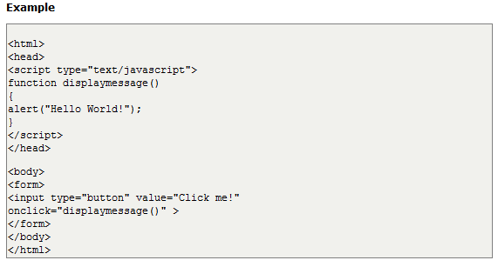
Functions can be defined both in the <head> and in the <body> section of a document. However, to assure that the function is read/loaded by the browser before it is called, it could be wise to put it in the <head> section.

Slide 42
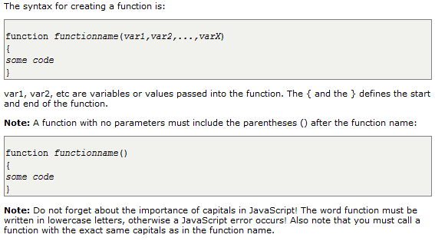
How to Define a Function
The syntax for creating a function is:

Slide 43
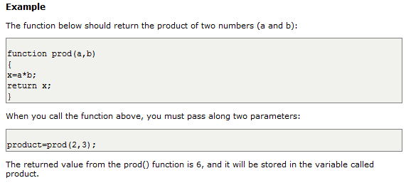
The return Statement
The return statement is used to specify the value that is returned from the function.
So, functions that are going to return a value must use the return statement.

